Slide 1
STANDY

Slide 2

Sunny or cloudy today?
Warm and cold
Pleasant and unpleasant
We can feel the atmosphere
by seeing the sky

Slide 3
If we can see an abstract information on the sky,
We can obtain an ability
of feeling the atmosphere
which we cannot see
in real world

Slide 4
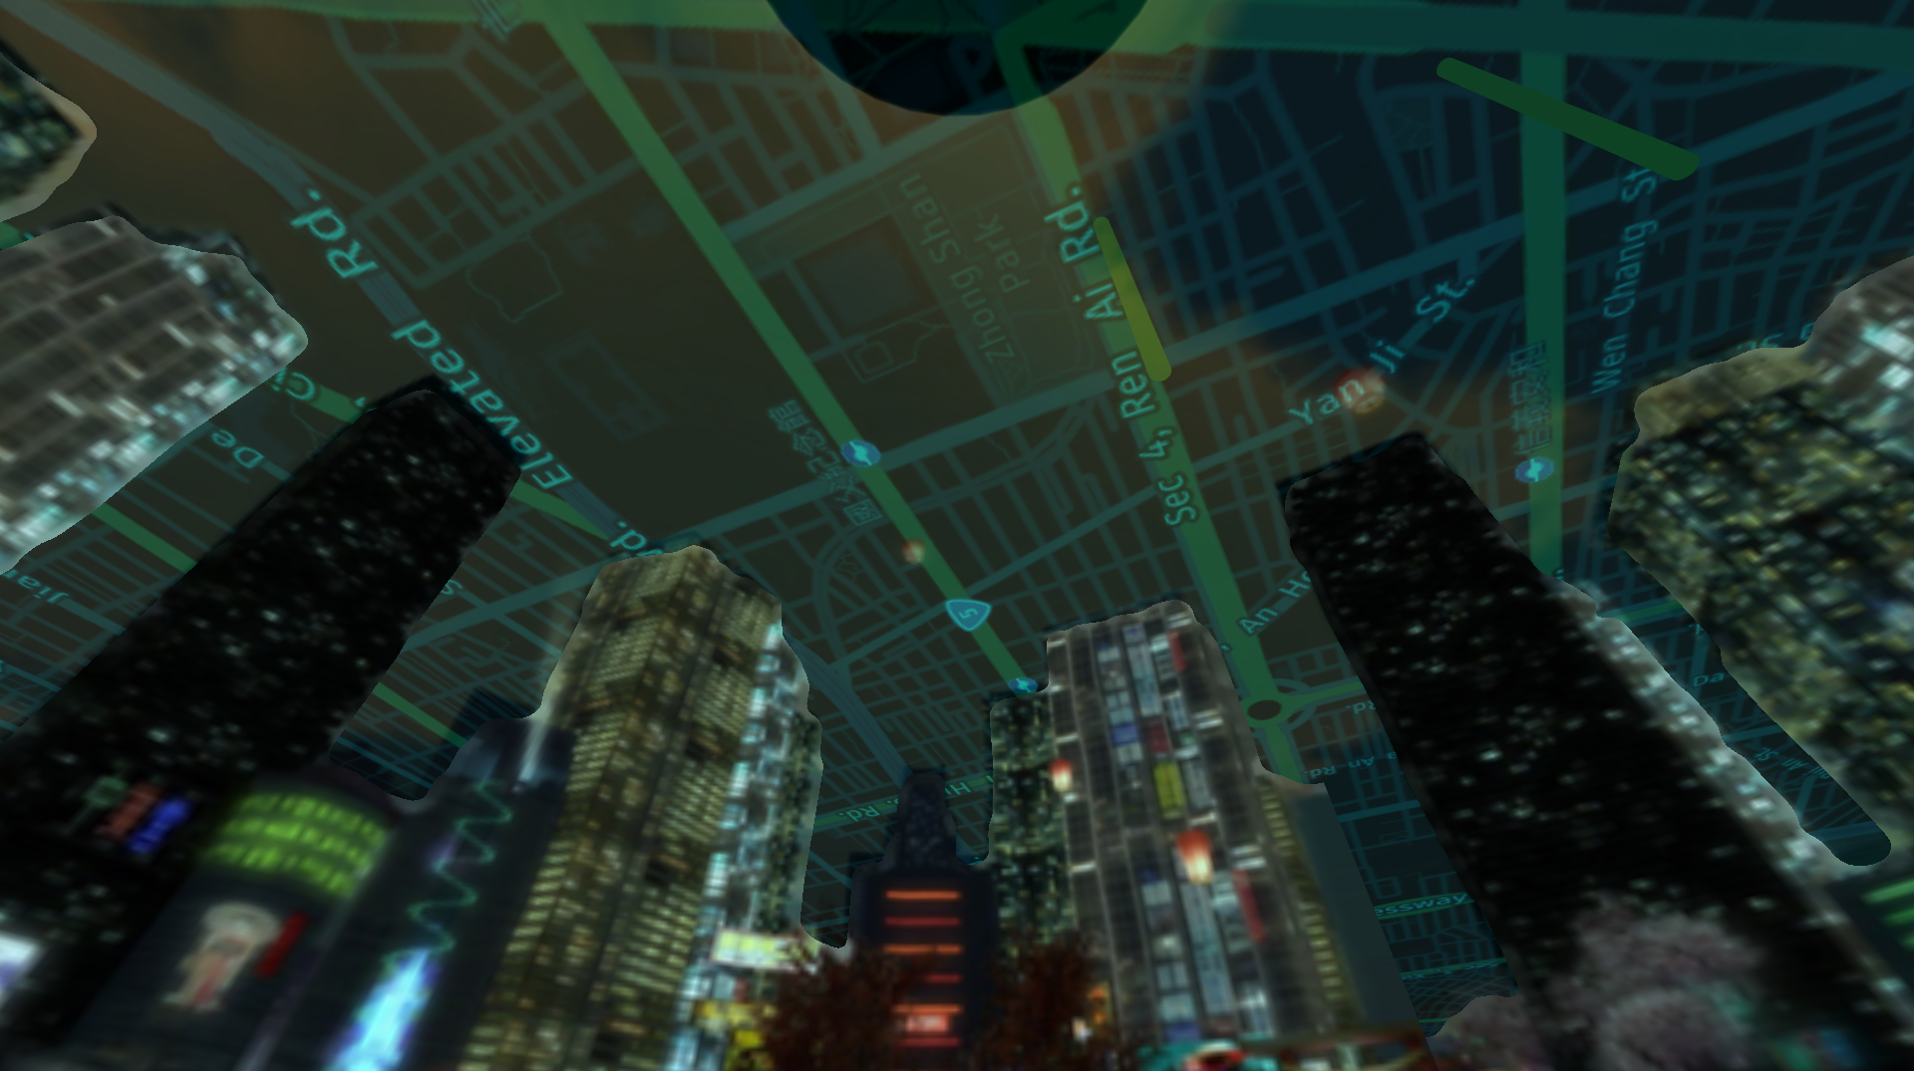

Slide 5
Sentiments
in
Augmented Reality

Slide 6
When we came to
an unfamiliar place

Slide 7
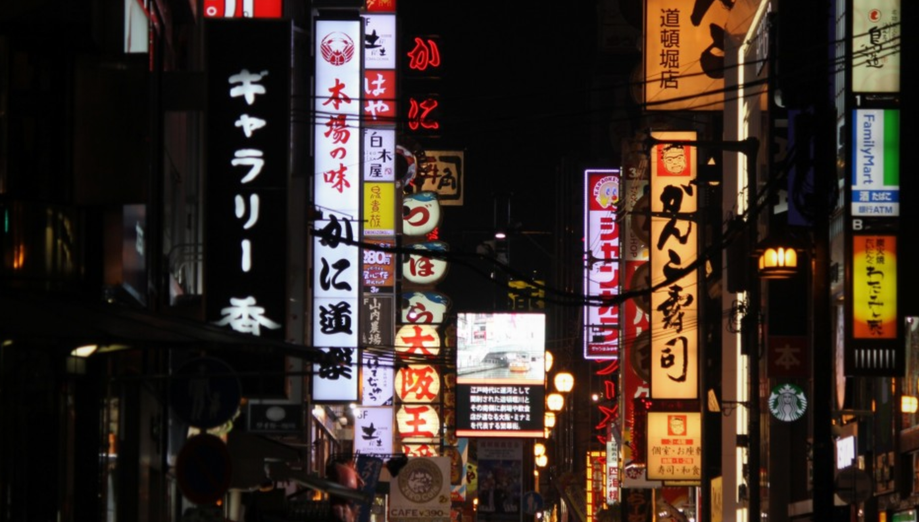

Slide 8
or a disaster situation

Slide 9
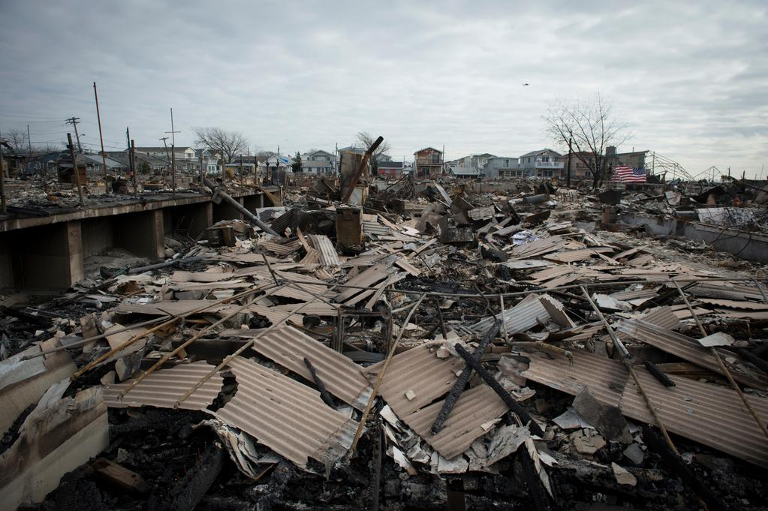

Slide 10

Only the information
is not enough.
Sometimes
an instinct
understanding
is important.

Slide 11

We understand the situation
by experiencing of body.
That is associated with actual position, size
and atmosphere including sounds and…

Slide 12

Sentiments.

Slide 13
So we combine
the Augmented Reality
and
Sentiments

Slide 14
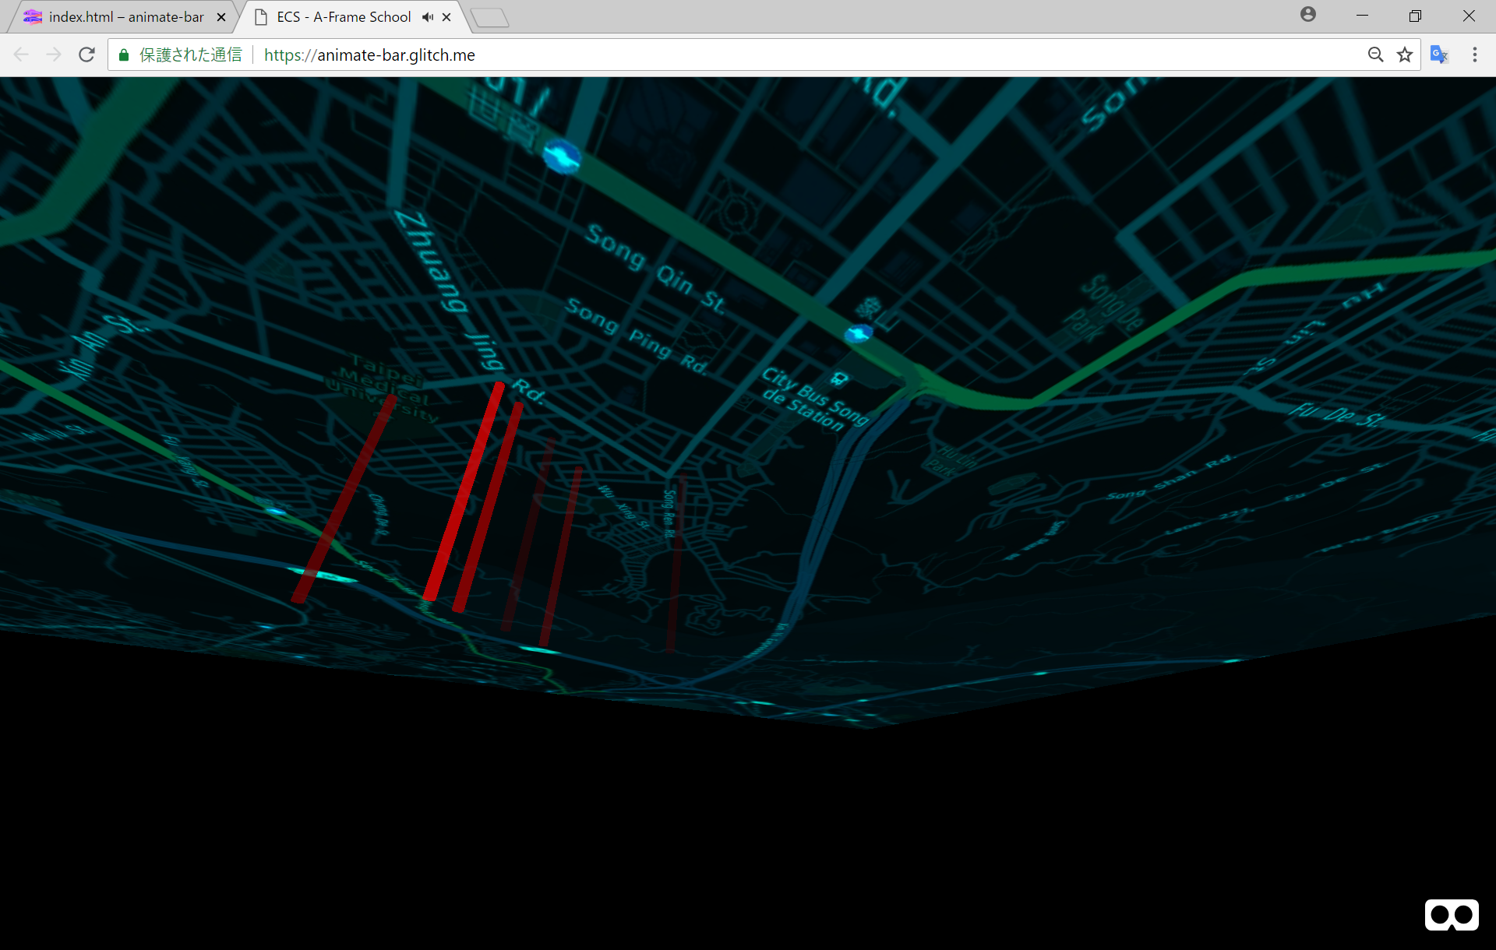


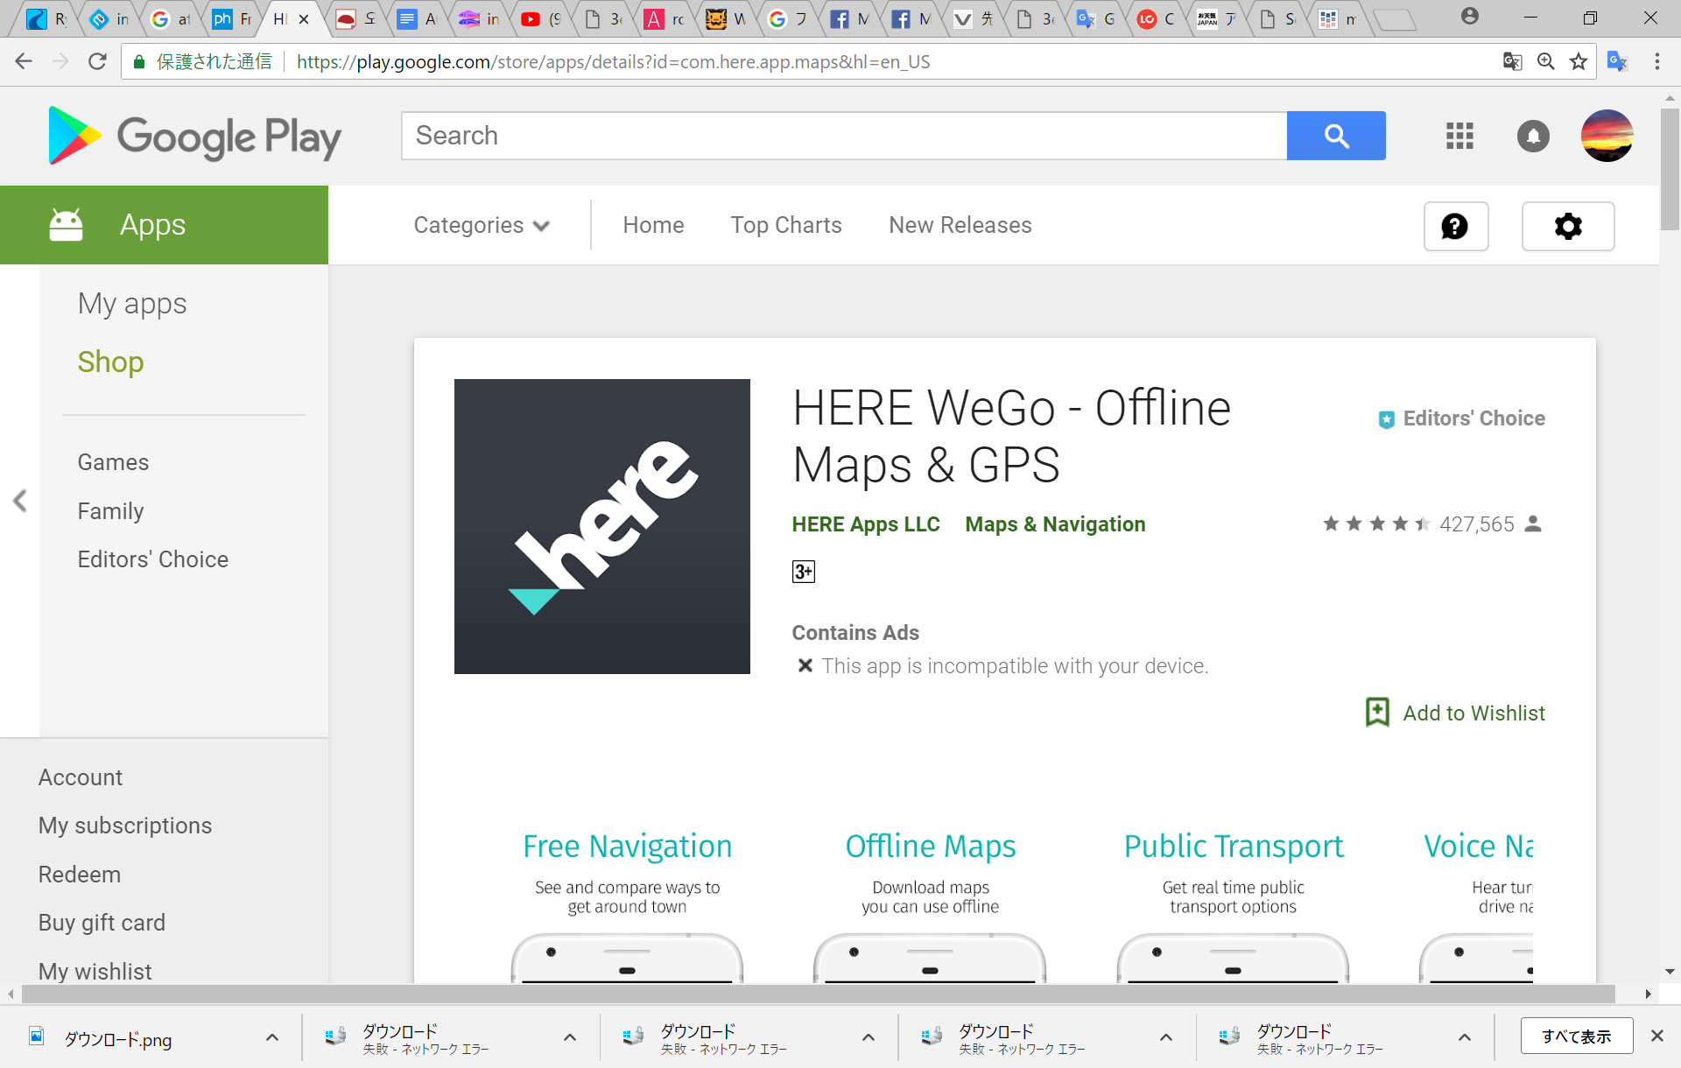

We gathered information from Twitter
and calculate sentiment using Natural Language Processing API and mapped on the sky.
The color of indicator shows the sentiment (red as bad, green as good)
And movement and altitude is associated to how old the tweet is.
At the sky we place the map using API

Slide 15
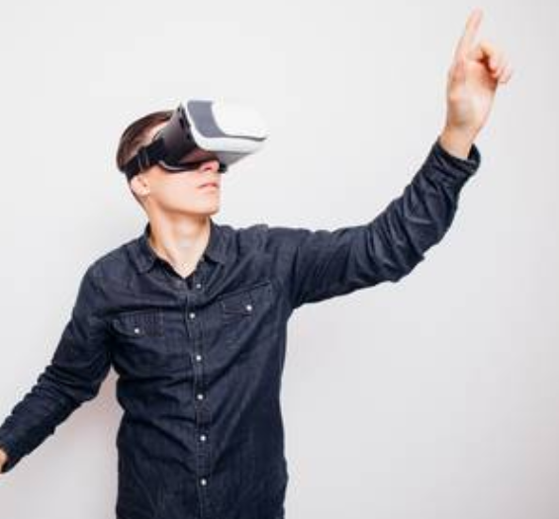

$$\frac{\sum{(sentiment ×} x)}{\sum{sentiment}}$$
From sentiments,
we point out where to go.
Users can find the direction
from the sound.
The sound is associated to
the position of the place
where we should go .
Today we decide it by calculating
the weight point
of all tweets’ sentiments.

Slide 16
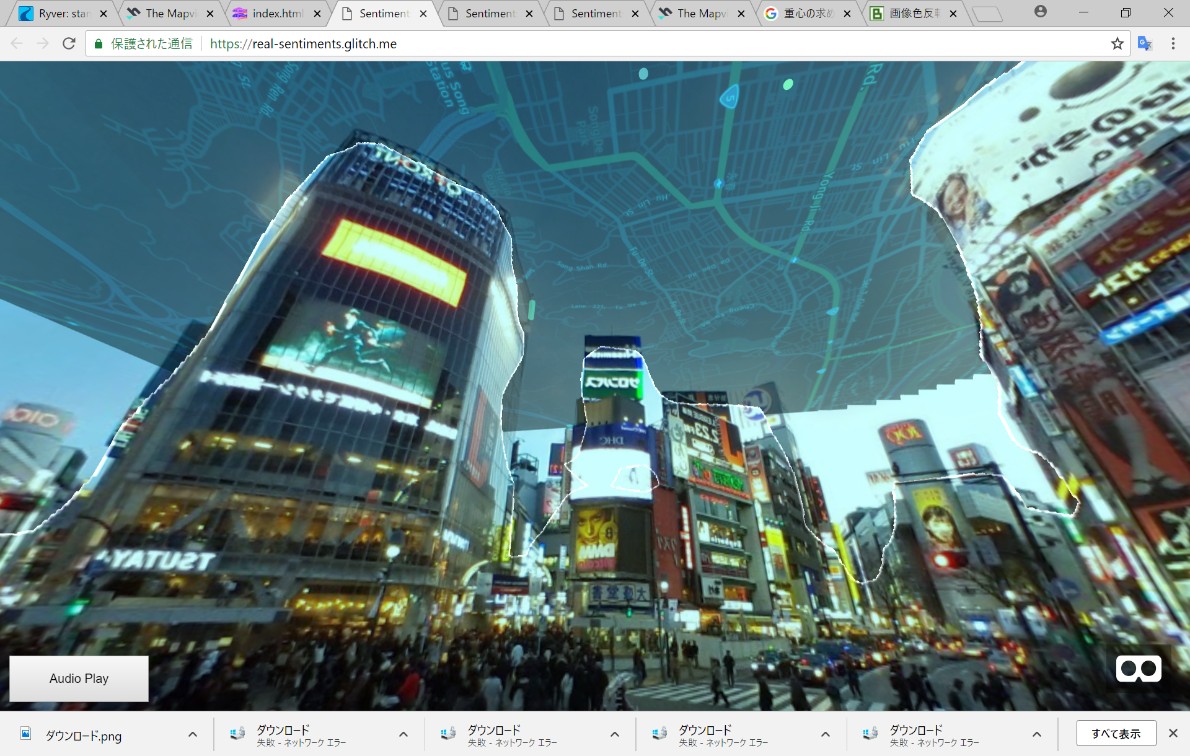


To avoid overwrapping the data mapped on the sky in front on building, we use Deep Learning model “SegNet”.
This model is originally provided by Univ of Cambridge for research in automatic driving.

Slide 17
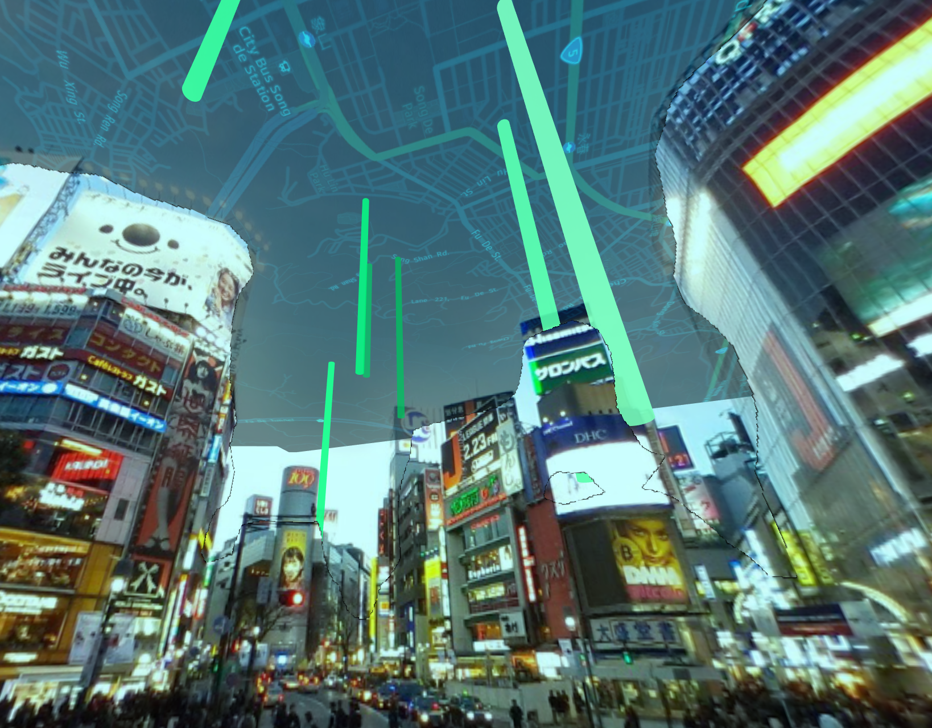
Shibuya, Tokyo
July 22nd 11:00
From the indicator circle,
we can know
where in neighborhood
is pleasant
Twitter is the fastest source,
we can recognize the
sentiments
even if we cannot understand
the language.

Slide 18
System overview
Google Streetview
backend
Python
SegNet
Frontend
Javascript
A-frame
Glitch
HMD
(Oculus Go
etc)
Google
Natural
Language
Processing
API
Smartphone
PC
twitter

Slide 19
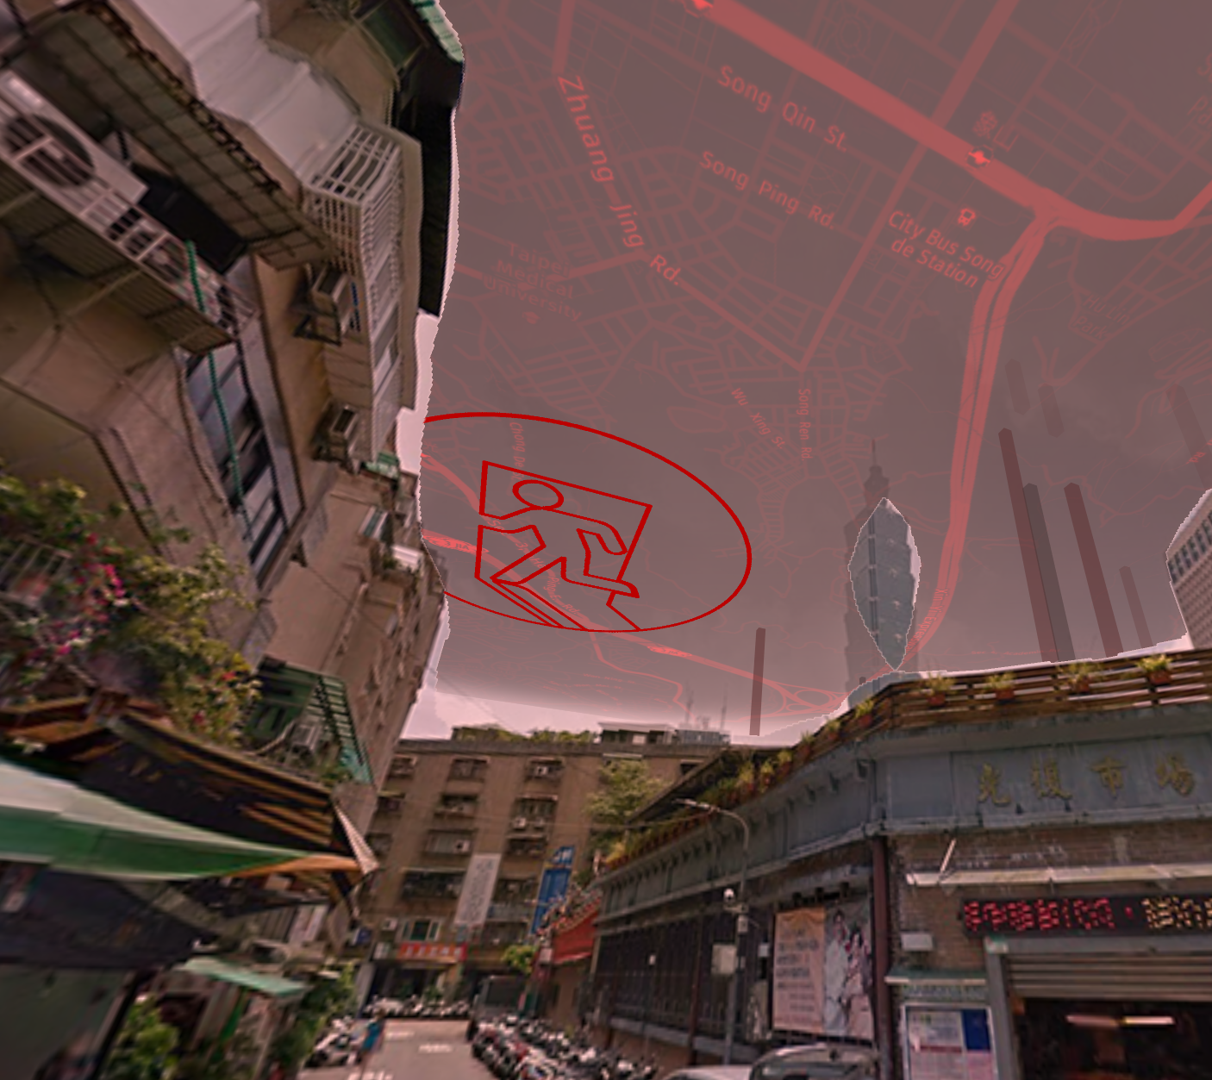
Taipei July 21st 13:00
Air Pollution;
Sky color becomes red because dust quantity here is so high (5.13pt) compared to
average in Taipei (4.55pt).
We extracted Open Data in Taiwan
Disaster Situation;
If many sentiments
became bad,
the evacuation area
acquired from Open Data
is indicated
by destination circle.
This time we multiplied the sentiments by 0.3
to simulate disaster situation

Slide 20
International Open Data
Worldwide data from Twitter with location,
Evacuation Area information,
here-API, Google Streetview
and Taipei Airpollution report.
Sentiments are calculated by Google NLP API
in many languages.
Creativity
Quite new visualization ways for data
to feel the body experience in subconscious;
Mapping the information on sky
and using the sound source
to notice the direction to the user.
Business viability
Using the sky as a screen become a media platform
including advertisement
Technical difficulty and
Detecting the building in front of the mapped data
utilize Deep Learning model provided
by Univ of Cambridge
And utilize it by our own method “Double Sphere Mapping”
application value

Slide 21
Sky is the big canvas
which lead us to the new stage of awareness

Slide 22

STANDY
Asia Open Data Hackathon 2018
Koichi Okada
Rohit Kumar Singh
Tang Li Qun
Satoshi Yanagisawa
International Open Data
Worldwide data from
Twitter with location,
here-API, Google Streetview.
And sentiment is calculated by
Google NLP API
in many languages.
Creativity
Quite new visualization ways for data
to feel the body experience in subconscious;
Mapping the information on sky
and using the sound source
to notice the direction to the user.
Business viability
Using the sky as a screen become a media platform
including advertisement
Technical difficulty and
Detecting the building in front of the mapped data
utilize Deep Learning model provided
by Univ of Cambridge
And utilize it by our own method “Double Sphere Mapping”
application value

Slide 23
International Open Data
Worldwide data from
Twitter with location,
here-API, Google Streetview.
And sentiment is calculated by
Google NLP API
in many languages.
Creativity
Quite new visualization ways for data
to feel the body experience in subconscious;
Mapping the information on sky
and using the sound source
to notice the direction to the user.
Business viability
Using the sky as a screen become a media platform
including advertisement
Technical difficulty and
Detecting the building in front of the mapped data
utilize Deep Learning model provided
by Univ of Cambridge
And utilize it by our own method “Double Sphere Mapping”
application value

